Slide 1
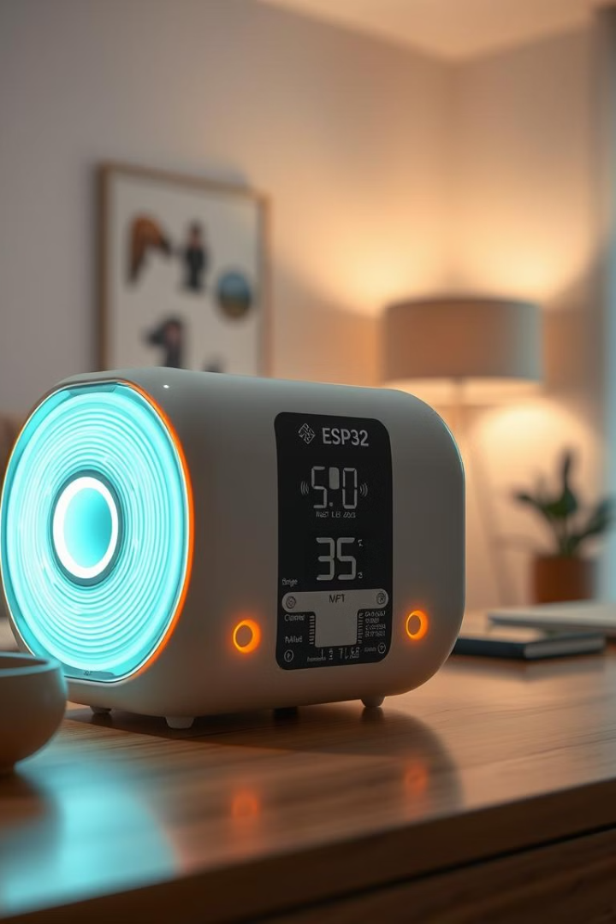
Air Quality Monitoring System Using ESP32 and AWS IOT
Welcome to our innovative Air Quality Monitoring System, a cutting-edge solution that combines the power of ESP32 microcontrollers with the scalability of Amazon Web Services (AWS). This project addresses the critical need for real-time air quality monitoring in our increasingly polluted world. By leveraging IoT technology and cloud computing, we've created a system that not only collects and analyzes air quality data but also provides timely alerts to ensure a safer, healthier environment.
Our system represents a significant step forward in environmental monitoring, offering real-time insights and actionable data to help mitigate the risks associated with poor air quality. Join us as we explore the intricate details of this project, from its hardware components to its cloud-based analytics capabilities.

Slide 2
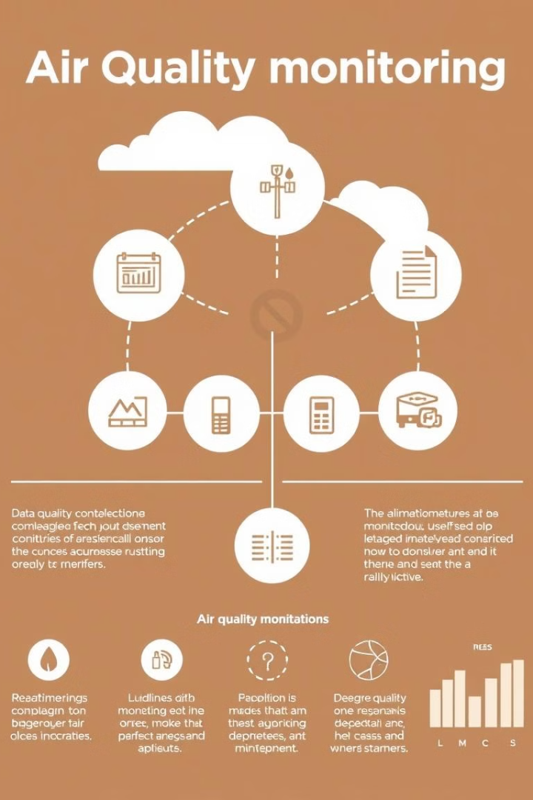
Project Overview and Objectives
1
Real-time Air Quality Monitoring
Our primary objective is to create a system that continuously monitors air quality parameters, providing up-to-the-minute data on various pollutants and gases present in the environment. This real-time monitoring capability allows for immediate awareness of any changes in air quality.
2
Intelligent Alert System
We've implemented a smart alert mechanism that triggers warnings when air quality deteriorates beyond predefined thresholds. This proactive approach enables quick responses to potentially hazardous conditions, enhancing safety and health protection.
3
Cloud-based Data Storage and Analysis
Leveraging AWS's powerful cloud infrastructure, our system stores vast amounts of air quality data for long-term analysis. This enables us to identify trends, patterns, and correlations in air quality over time, providing valuable insights for environmental research and policy-making.
4
Scalable and Flexible Architecture
By utilizing ESP32 microcontrollers and AWS services, we've created a highly scalable and flexible system. This architecture allows for easy expansion to monitor multiple locations and integration with other smart home or industrial systems.

Slide 3
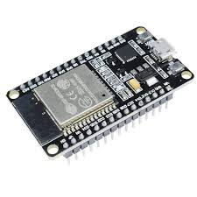
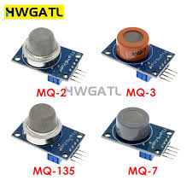
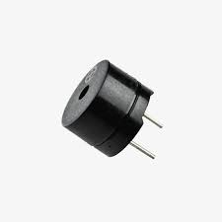
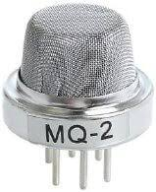
Hardware Components
ESP32 Microcontroller
Gas Sensors Suite
Alert System
At the heart of our system is the ESP32, a powerful and versatile microcontroller. It features built-in Wi-Fi and Bluetooth capabilities, making it ideal for IoT applications. The ESP32 processes data from multiple sensors and securely transmits it to AWS, acting as the bridge between the physical environment and the cloud.
A piezoelectric buzzer serves as our primary alert mechanism. It's programmed to emit distinct audio signals based on the severity of air quality deterioration, providing immediate audible warnings to occupants. This component is essential for ensuring prompt action in case of dangerous gas levels.
We employ a trio of high-precision gas sensors: MQ2, MQ7, and MQ135. The MQ2 sensor detects a range of combustible gases, including LPG and smoke. The MQ7 is specifically calibrated for carbon monoxide detection, crucial for indoor air quality. The MQ135 rounds out our sensor array by detecting ammonia, sulfur, benzene, and other harmful gases.

Slide 4
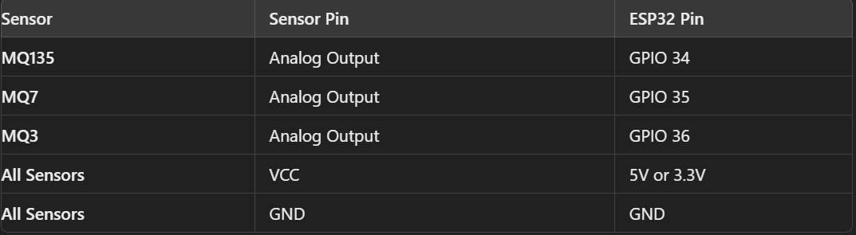
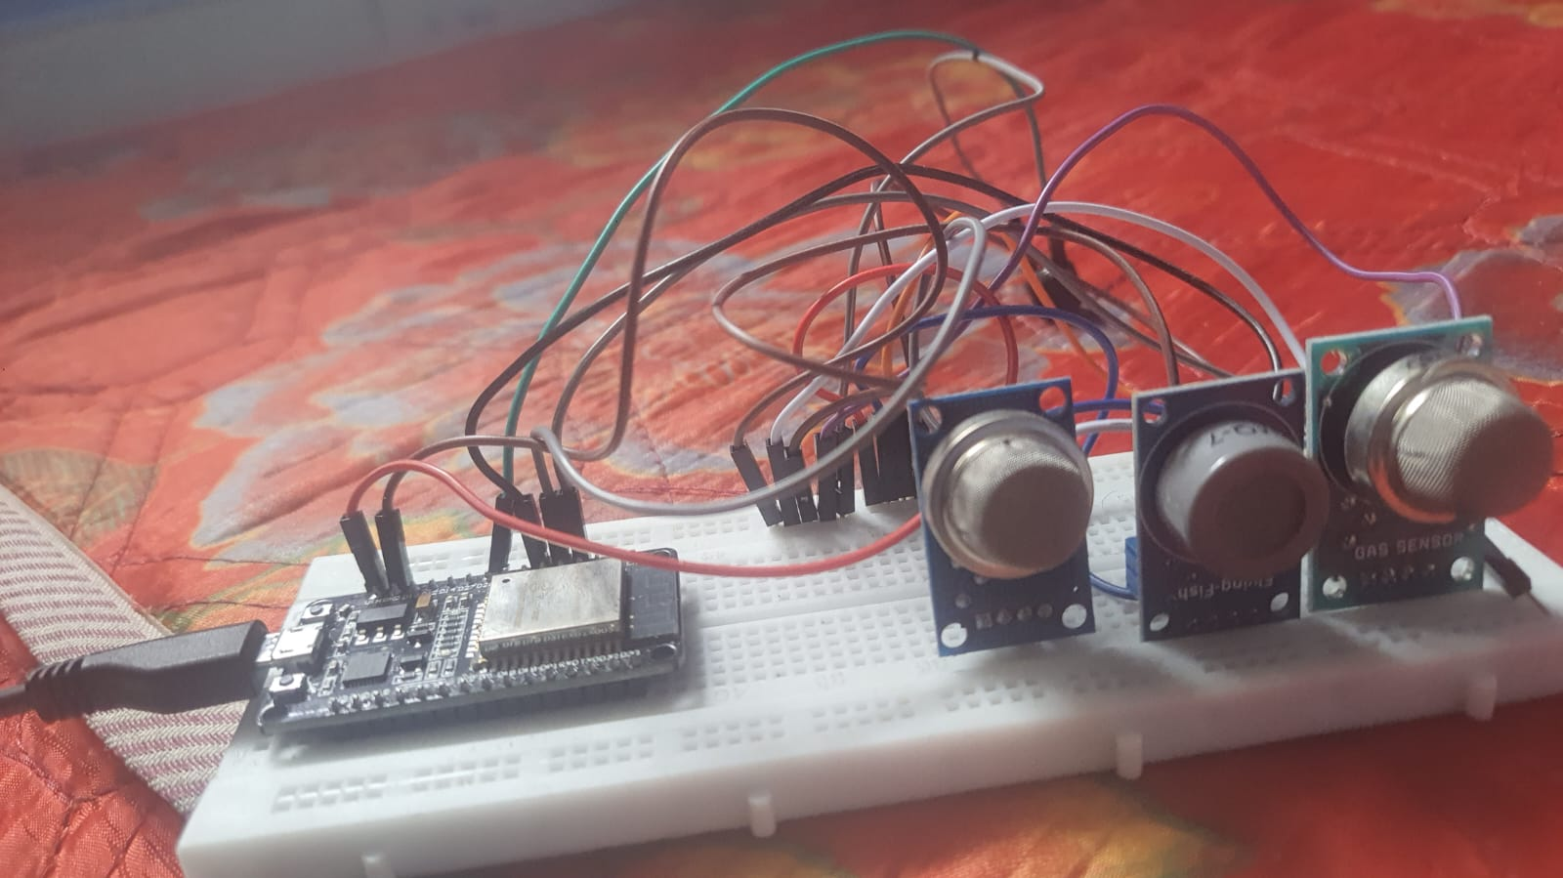
Connections Of Components
Buzzer –
GPIO26 – FOR POSITIVE TERMINAL
AND GND FOR NEGATIVE TERMINAL

Slide 5
Software Components
1
Arduino IDE
We use Arduino IDE as our primary development environment for programming the ESP32. Its user-friendly interface and extensive library support make it ideal for rapid prototyping and deployment of our air quality monitoring firmware.
2
AWS IoT Core
AWS IoT Core serves as the central hub for device connectivity and message routing. It ensures secure, bi-directional communication between our ESP32 devices and other AWS services, managing device authentication and data encryption.
3
Amazon DynamoDB
Our system leverages DynamoDB, a fast and flexible NoSQL database service, to store the continuous stream of sensor data. Its scalability and low-latency performance make it perfect for handling real-time data from multiple devices.
4
AWS Glue and Glue Crawler
AWS Glue is utilized for ETL (Extract, Transform, Load) operations, preparing our raw sensor data for analysis. The Glue Crawler automatically discovers and catalogs our data, making it readily available for analytics and machine learning processes.
5
AWS Kinesis
Kinesis enables real-time data streaming and analytics, allowing us to process and analyze air quality data as it's being collected. This capability is crucial for immediate detection of air quality issues and trend analysis.

Slide 6
CODE EXPLANATION
Purpose: This code monitors air quality using MQ135, MQ7, and MQ3 sensors, then sends the data to AWS IoT Core for analysis and alerts.
Hardware: ESP32 microcontroller, MQ135 (CO2), MQ7 (CO), MQ3 (Alcohol) sensors.
Communication: Wi-Fi for connectivity, MQTT for communication with AWS IoT.
Key Components:
1. Wi-Fi Setup:
- Connects ESP32 to the specified Wi-Fi network.
2. AWS IoT Core Integration:
- Secures communication using SSL certificates (Root CA, Device Certificate, Private Key).
- Connects to AWS IoT Core to publish sensor data.
3. Sensor Data Acquisition:
- Reads values from MQ135, MQ7, and MQ3 sensors using analog pins.
- Converts raw sensor data to PPM (Parts Per Million) values.
4. Air Quality Evaluation:
- Determines air quality status ("Good" or "Poor") based on sensor thresholds.
5. Timestamp Synchronization:
- Retrieves and formats the current time using NTP (Network Time Protocol).
6. Data Publishing:
- Sends a JSON payload with sensor data, air quality status, and timestamp to AWS IoT.
7. *Error Handling:*
- Reconnects to AWS IoT if the connection drops.
*Functions Overview:*
- connectToWiFi(): Connects to Wi-Fi.
- setupAWSIoT(): Configures AWS IoT connection.
- setupMQSensors(): Initializes sensor pins.
- readMQ135(), readMQ7(), readMQ3(): Reads and processes sensor data.
- evaluateAirQuality(): Determines air quality based on sensor values.
- getTimestamp(): Retrieves the current timestamp.
- publishToAWSIoT(): Publishes data to AWS IoT Core.
- messageReceived(): Handles incoming MQTT messages

Slide 7
CODE EXPLANATION
7. Error Handling:
- Reconnects to AWS IoT if the connection drops.
Functions Overview:
- connectToWiFi(): Connects to Wi-Fi.
- setupAWSIoT(): Configures AWS IoT connection.
- setupMQSensors(): Initializes sensor pins.
- readMQ135(), readMQ7(), readMQ3(): Reads and processes sensor data.
- evaluateAirQuality(): Determines air quality based on sensor values.
- getTimestamp(): Retrieves the current timestamp.
- publishToAWSIoT(): Publishes data to AWS IoT Core.
- messageReceived(): Handles incoming MQTT messages
CHECK THE CODE IN THIS LINK: https://gist.github.com/CHAVA-KETHAN-VU21CSEN0600007/a8c336aca45d9c71127981e46ff33126#file-gistfile1-txt

Slide 8
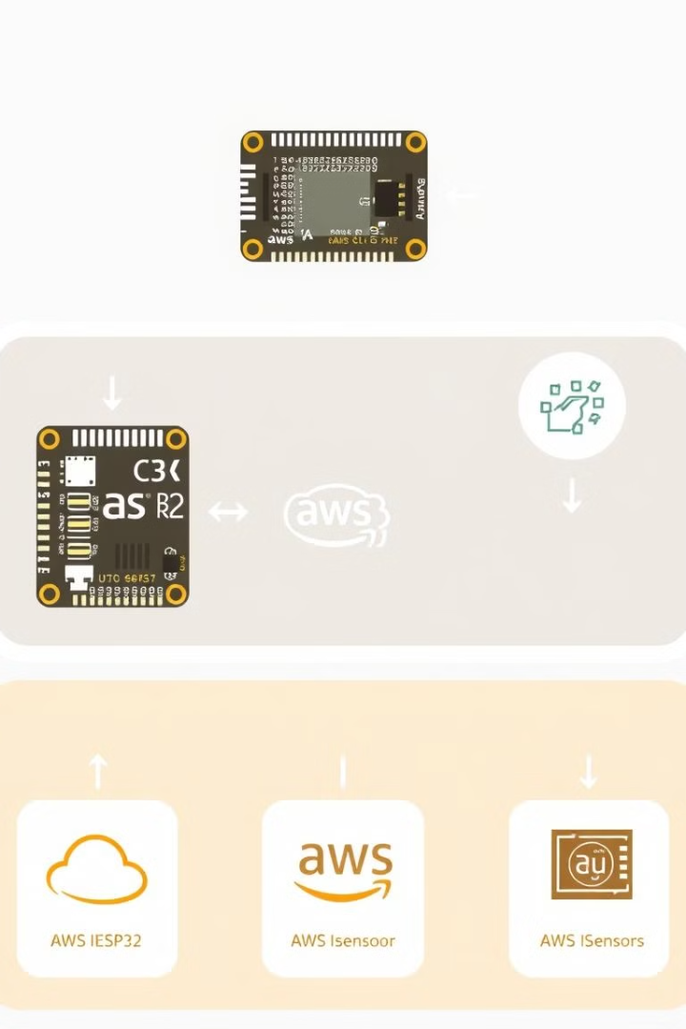




System Architecture
Data Collection
The process begins with our sensor array collecting real-time air quality data. The ESP32 microcontroller reads these sensors at regular intervals, packaging the data with timestamps and device identifiers.
Data Transmission
Using the MQTT protocol, the ESP32 securely publishes the collected data to AWS IoT Core. This lightweight messaging protocol is ideal for IoT applications, ensuring efficient and reliable data transmission.
Cloud Processing
Once received by AWS IoT Core, the data is routed to various AWS services. It's stored in DynamoDB for persistence, processed by AWS Glue for transformation, and streamed through Kinesis for real-time analysis.
Analysis and Alerting
Processed data is analyzed using AWS analytics services. If air quality thresholds are exceeded, the system triggers alerts. These can be sent back to the ESP32 to activate the buzzer or push notifications to mobile devices.

Slide 9
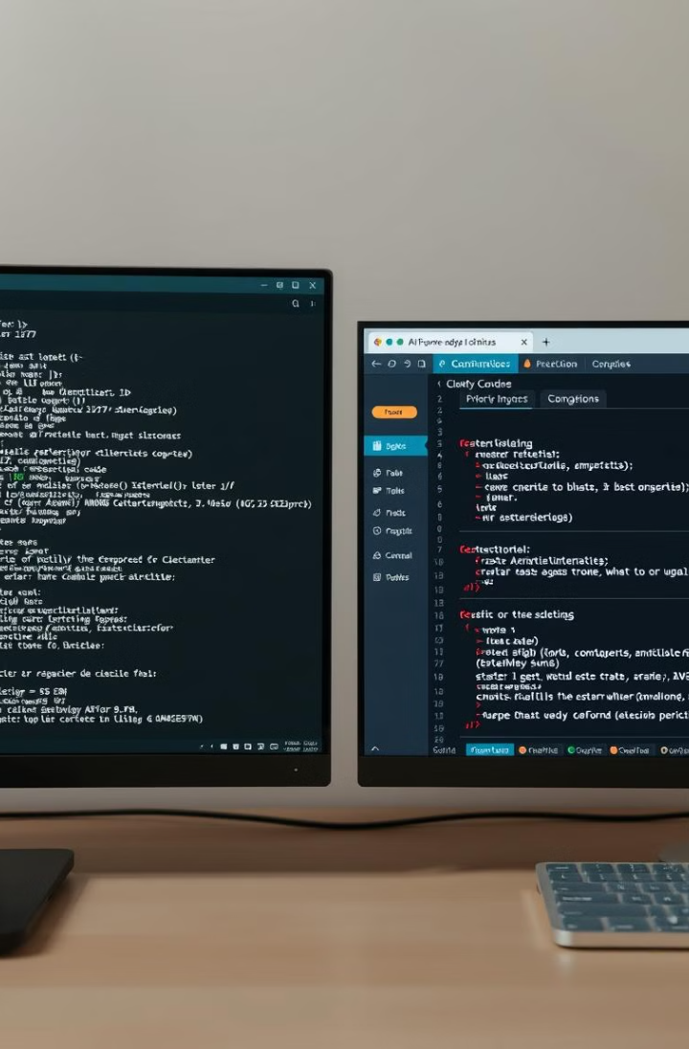
Implementation Details
Component
Implementation Details
ESP32 Firmware
Developed in Arduino IDE, includes sensor reading functions, MQTT client for AWS IoT Core communication, and JSON formatting for data transmission.
AWS IoT Core Setup
Created a 'thing' for each ESP32 device, configured security policies, and generated certificates for secure communication.
DynamoDB Schema
Designed with a partition key of 'DeviceID' and sort key of 'Timestamp' for efficient data retrieval. Includes columns for each gas sensor reading.
AWS Glue ETL
Created Glue jobs to clean and transform raw sensor data, converting gas sensor readings to ppm (parts per million) and calculating air quality indices.
Kinesis Data Streams
Configured to ingest real-time data from IoT Core and feed it into analytics applications for immediate processing and alerting.

Slide 10
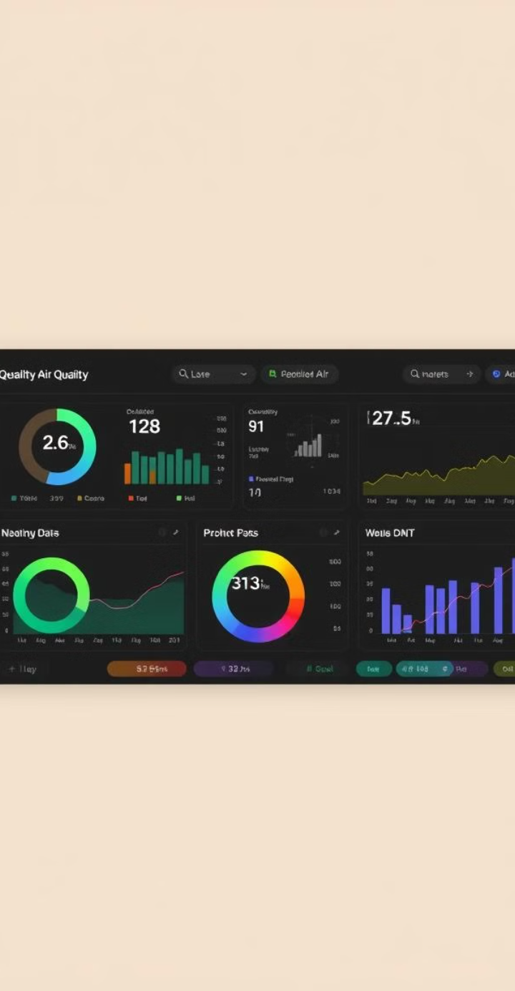




Data Analysis and Results
Trend Analysis
Our system's data analysis capabilities have revealed significant air quality trends. We've observed consistent patterns in CO2 levels correlating with human activity, peaking during work hours and decreasing at night.
Anomaly Detection
Leveraging AWS's machine learning services, we've implemented anomaly detection algorithms. These have successfully identified unusual spikes in pollutant levels, often traced back to specific events or malfunctioning equipment.
Seasonal Variations
Long-term data analysis has uncovered seasonal variations in air quality. We've noted higher particulate matter levels during winter months, likely due to increased use of heating systems and reduced air circulation.
Decision Support
Our analysis provides valuable decision support for building managers and environmental agencies. By correlating air quality data with other factors like weather and traffic, we enable more informed policy-making and resource allocation.

Slide 11
Challenges and Solutions
Hardware Challenges
Software Challenges
Solutions and Optimizations
One of the primary challenges we faced was sensor calibration. Each MQ series sensor required precise calibration to ensure accurate readings across different environmental conditions. We developed a rigorous calibration protocol, using controlled gas mixtures to establish baseline readings and adjustment factors.
Integrating multiple AWS services presented complex software challenges. Ensuring seamless data flow from IoT Core through to analytics services required careful configuration and extensive testing. We overcame this by creating a detailed system architecture diagram and implementing each component incrementally, thoroughly testing each integration point.
To enhance system reliability, we implemented a local data caching mechanism on the ESP32. This allows the device to store sensor readings temporarily if the connection to AWS is lost, transmitting the cached data once connectivity is restored.
We also developed a comprehensive monitoring and alerting system for our AWS infrastructure, using CloudWatch to track resource utilization and service health. This proactive approach allows us to address potential issues before they impact data collection or analysis.
Connectivity issues also posed a significant hurdle, particularly in areas with weak Wi-Fi signals. To address this, we implemented a robust error handling and retry mechanism in our ESP32 firmware, ensuring data integrity even in unstable network conditions.
Data processing at scale was another significant challenge. As our system collected vast amounts of data, we needed to optimize our AWS Glue jobs and DynamoDB queries for performance. We implemented partitioning strategies and fine-tuned our ETL processes to handle the data volume efficiently.

Slide 12

Conclusion and Future Work
Project Achievements
Our Air Quality Monitoring System has successfully demonstrated the power of combining IoT devices with cloud computing for environmental monitoring. We've created a scalable, real-time system that not only collects and analyzes air quality data but also provides actionable insights and timely alerts.
Impact and Applications
The system's applications extend beyond individual buildings to smart city initiatives, industrial safety, and environmental research. By providing accurate, real-time air quality data, we're enabling better decision-making for public health and environmental policies.
Future Enhancements
Looking ahead, we plan to expand the system's capabilities by incorporating additional environmental sensors, such as particulate matter and ozone detectors. We're also exploring the integration of machine learning models for predictive analytics, allowing us to forecast air quality trends and potential pollution events.
Call to Action
We invite collaboration from environmental scientists, IoT enthusiasts, and cloud computing experts to further enhance this system. By open-sourcing key components of our project, we aim to foster innovation in environmental monitoring and contribute to global efforts in improving air quality.

